Slide 1
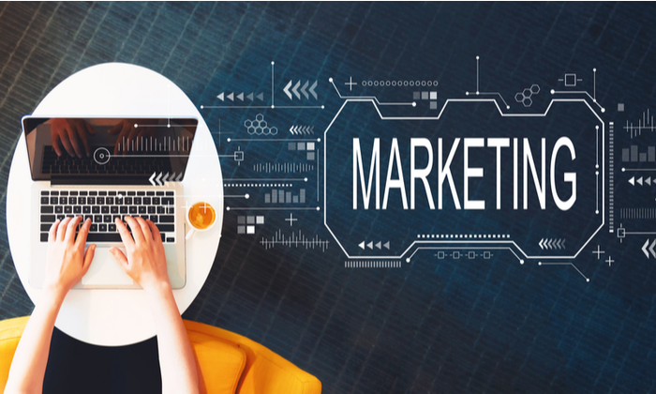
DIGITAL AND SOCIAL MEDIA MARKETING
UNIT-1

Slide 2
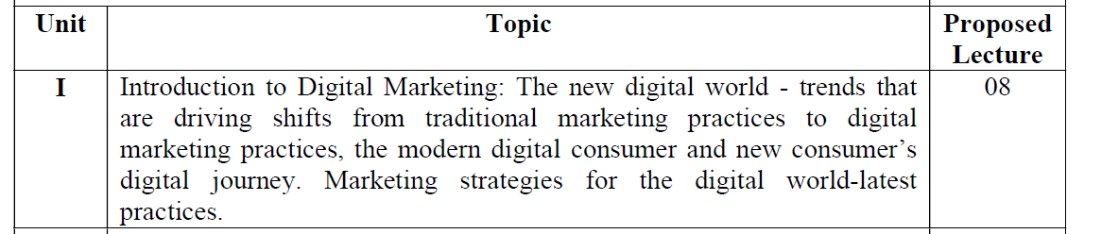
Text Books:
1. Moutsy Maiti: Internet Mareting, Oxford University Press India
2. Vandana, Ahuja; Digital Marketing, Oxford University Press India (November, 2015).
3. Eric Greenberg, and Kates, Alexander; Strategic Digital Marketing: Top Digital Experts
4. Share the Formula for Tangible Returns on Your Marketing Investment; McGraw-Hill
Professional.
5. Ryan, Damian; Understanding Digital Marketing: marketing strategies for engaging the
digital generation; Kogan Page.
6. Tracy L. Tuten & Michael R. Solomon: Social Media Marketing (Sage Publication)

Slide 3
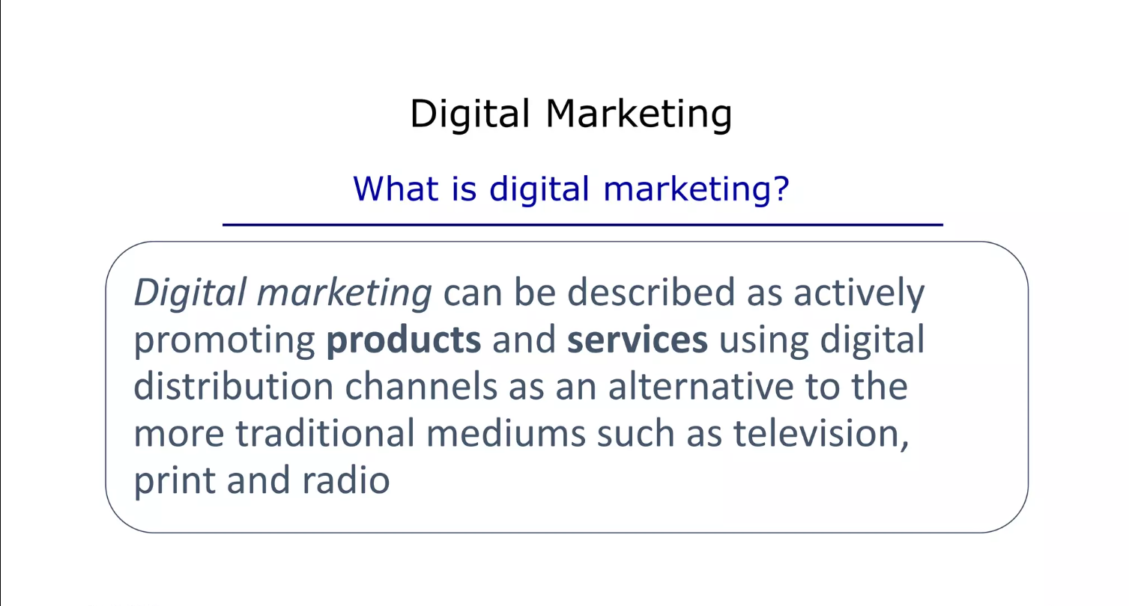

Slide 4
The term digital marketing became popular overtime, especially in certain countries. In the USA online marketing is still prevalent, in Italy is referred as web marketing but, in the UK, and worldwide, digital marketing has become the most common term, especially after the year 2013
Digital marketing is an umbrella term for the marketing of products or services using digital technologies, mostly on the Internet, but also including mobile phones, display advertising and any other digital terms.

Slide 5
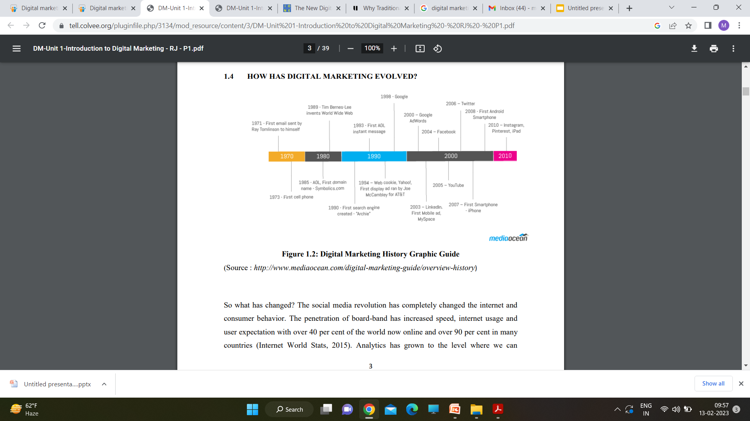

Slide 6
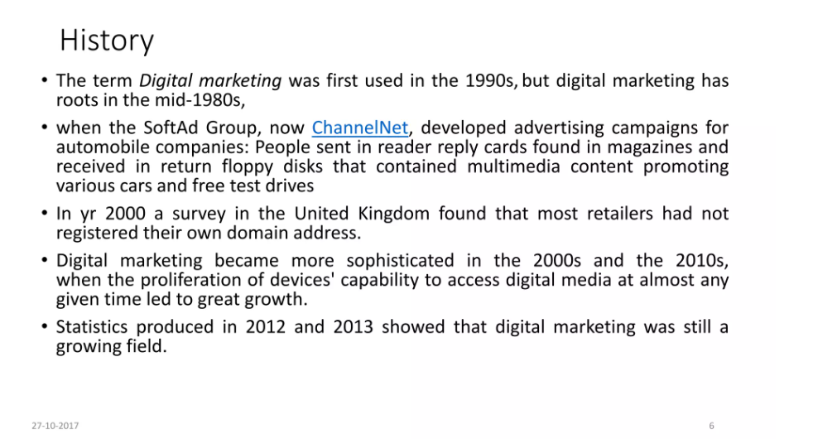

Slide 7
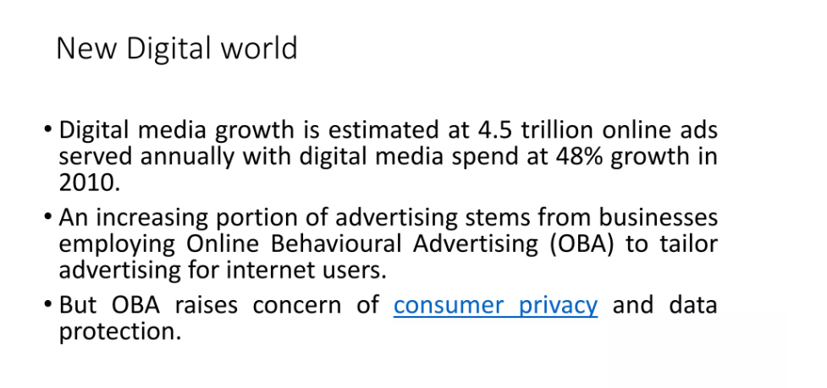

Slide 8
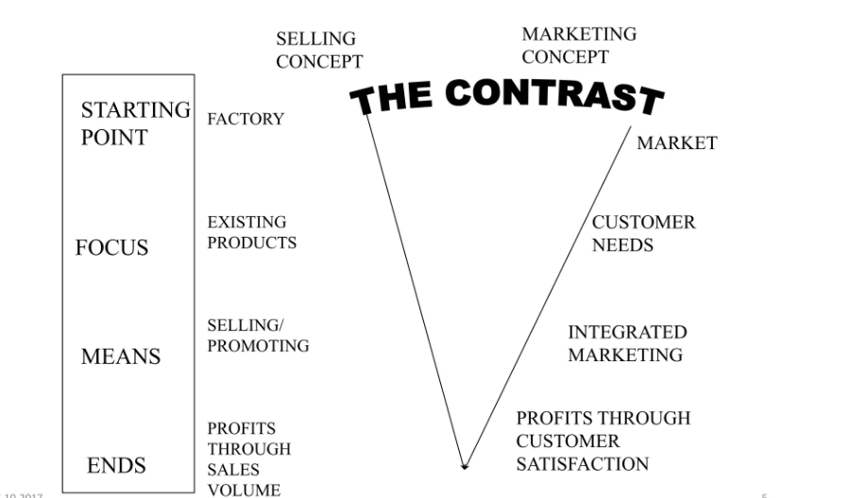

Slide 9
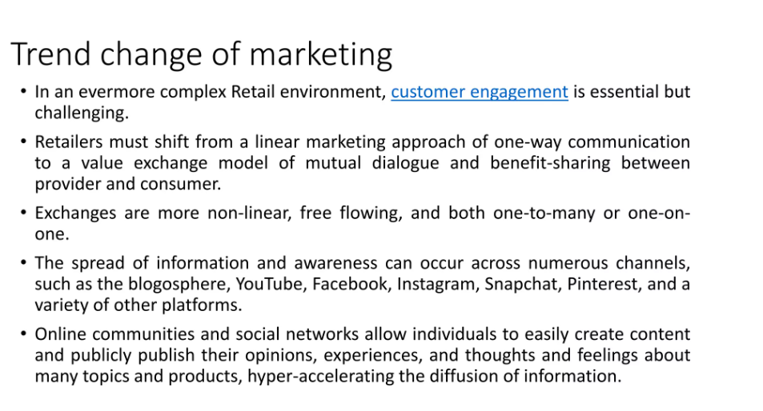

Slide 10
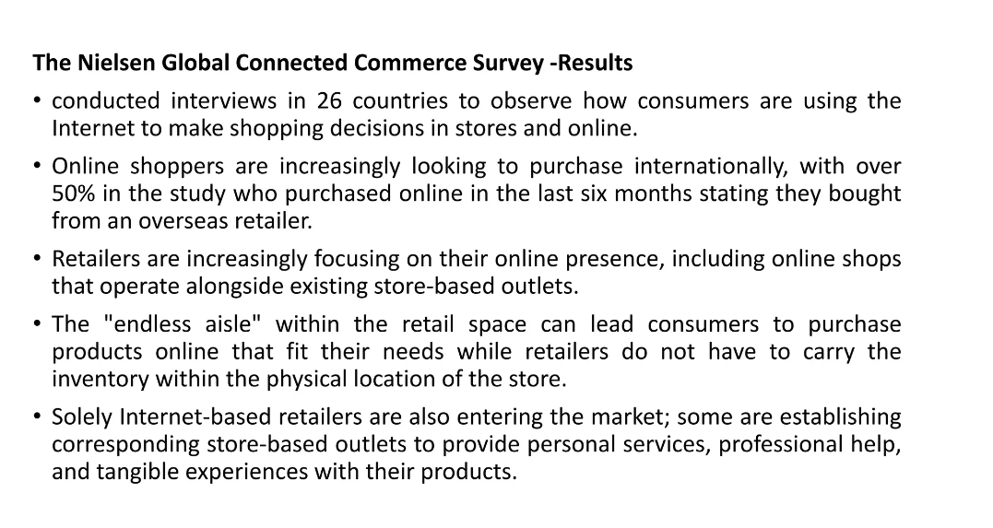

Slide 11
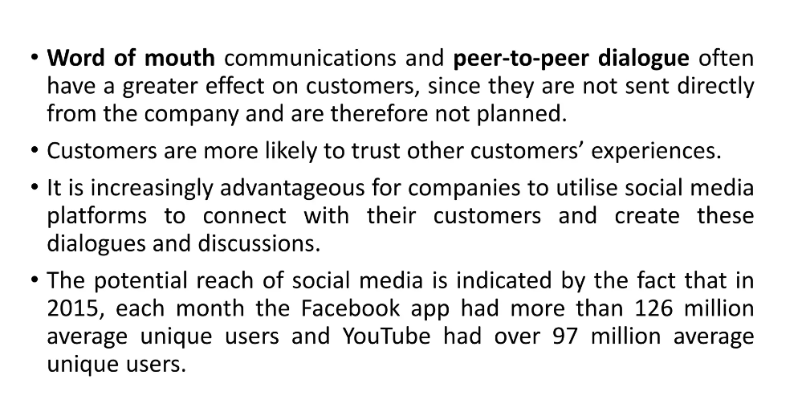

Slide 12
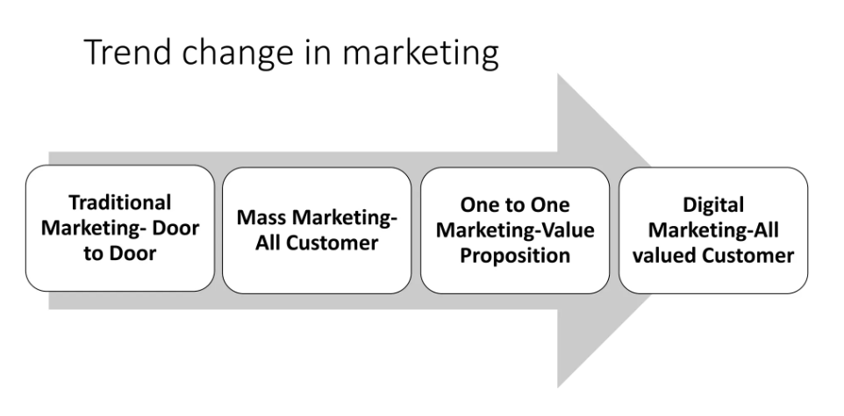

Slide 13
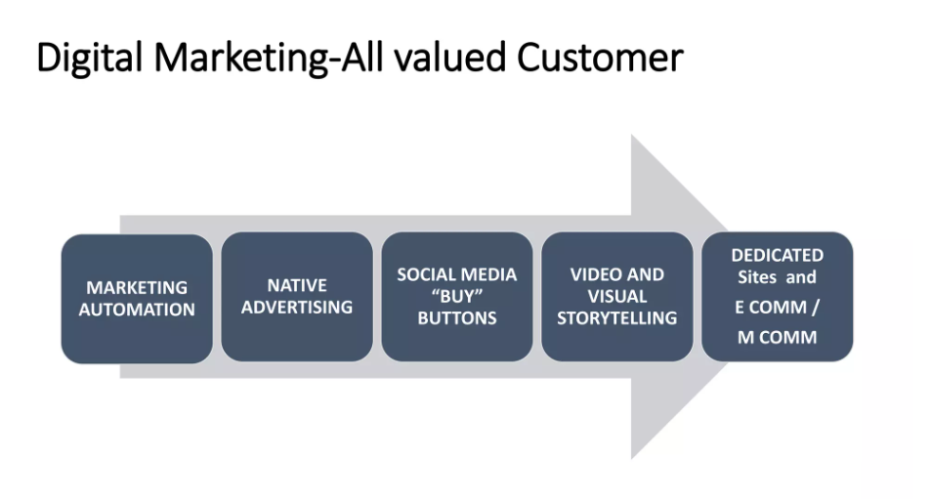

Slide 14
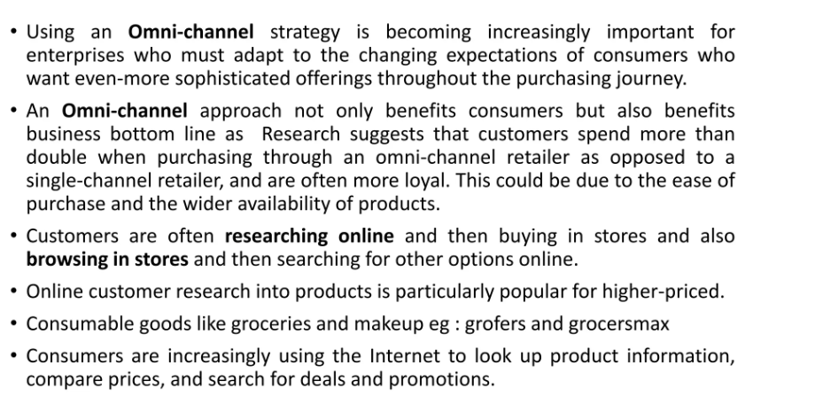

Slide 15
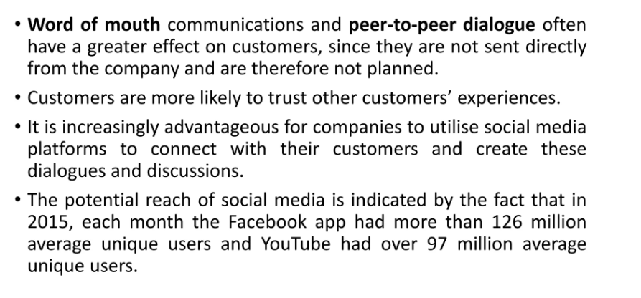

Slide 16
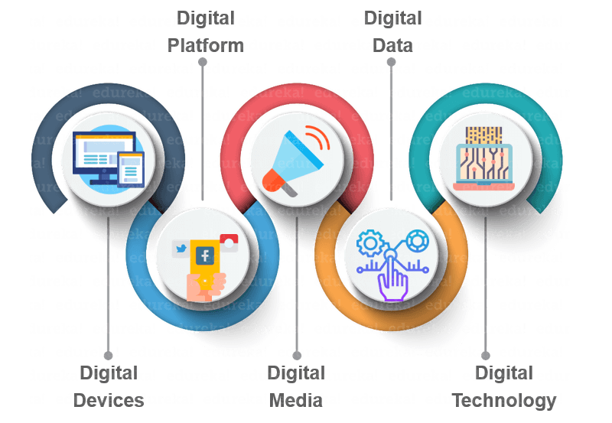
5D of Digital Marketing

Slide 17
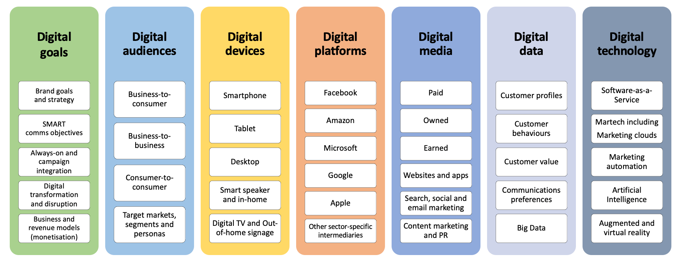
7D of Digital Marketing(Updated 2022)

Slide 18
Digital Devices
Audiences experience brands as they interact with business websites and mobile apps usually through a combination of connected devices which includes smartphones, tablets, desktop computers, TVs and gaming devices.
Digital Platforms
Most interactions on these devices are through a browser or apps from the major platforms or services, that’s Facebook (and Instagram), Google (and YouTube), Twitter and LinkedIn.

Slide 19
Digital Media
Different paid, owned and earned communications channels for reaching and engaging audiences including advertising email and messaging search engines and social networks.
Digital data
The insight businesses collect about their audience profiles and their interactions with businesses, which now need to be protected by law in most countries.
Digital technology
The marketing technology that businesses use to create interactive experiences from websites and mobile apps to in-store kiosks and email campaigns.

Slide 20
7D in Details
Digital Devices : audience experience as they interest with the business website and mobile apps through a combination of connected devices including smartphone, tablets , desktop computers, TV and gaming devices.
Digital Platform : most interaction on these devices through a browser or apps from the major platforms or services, that’s Facebook(and Instagram), Google(and YouTube), Twitter and LinkedIn.

Slide 21
Digital media – different paid, owned and earned media communications channels for reaching and engaging audiences including advertising, email and messaging, search engines and social networks. Owned media also include the company websites and/or apps and content strategy.
Digital data – the insight businesses collect about their audience profiles and their interactions with businesses which now needs to be protected by law in most countries.
Digital technology – the marketing technology or martech that businesses use to create interactive experiences from websites and mobile apps to in-store kiosks and email campaigns.

Slide 22
Digital goals – reviewing what the business or brand is aiming to achieve through using digital marketing, considering how digital marketing can help the business compete better through considering new business and revenue models and investing more in digital transformation and always-on marketing in addition to campaign investments which will have SMART objectives.
Digital audiences – understanding online audience characteristics, behaviors and preferences in order to deliver more relevant content and experiences to different target segments aimed at increasing interactions and so meeting business goals within the competitive online marketplace.

Slide 23
MarTech
Marketing technology, also known as MarTech, describes a range of software and tools that assist in achieving marketing goals or objectives. When a marketing team utilizes a grouping of marketing technologies, this is known as their marketing technology stack. MarTech has become a staple in digital marketing campaigns, but can also be used to optimize marketing efforts across any marketing channel.

Slide 24
Difference Between MarTech and AdTech
MarTech may sometimes be confused with Adtech. The difference between these programs is similar to the difference between marketing and advertising. While martech refers to technology that helps to create, communicate, and deliver offerings, adtech is strictly used to influence buyer behavior by promoting offerings. For example, Customer Relationship Management (CRM) software is martech, while social ad platforms are adtech.

Slide 25
DIFFERENCE BETWEEN TRADITIONAL MARKETING AND DIGITAL MARKETING
Traditional Marketing is when the marketing activities are undertaken in a conventional fashion, i.e. by way of newspaper, television radio and magazine. As against, digital marketing is when we use the online platform to promote the products and services of our company.
In traditional marketing the reach is local, whereas digital marketing is known for its global reach

Slide 26
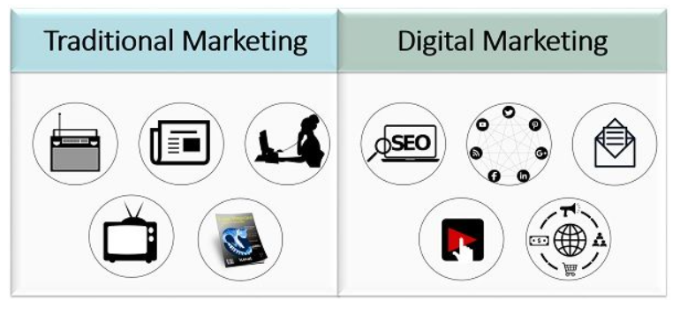

Slide 27
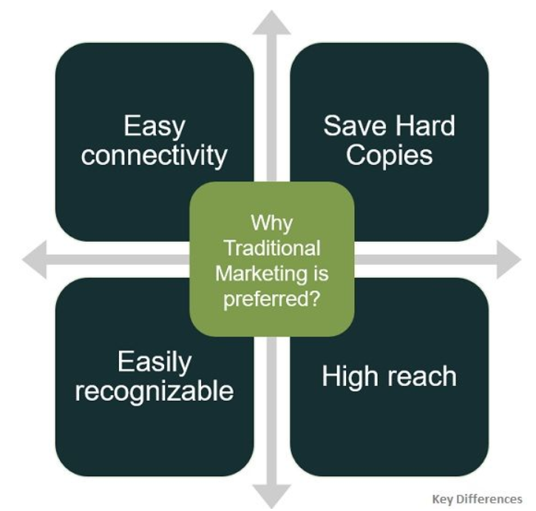

Slide 28
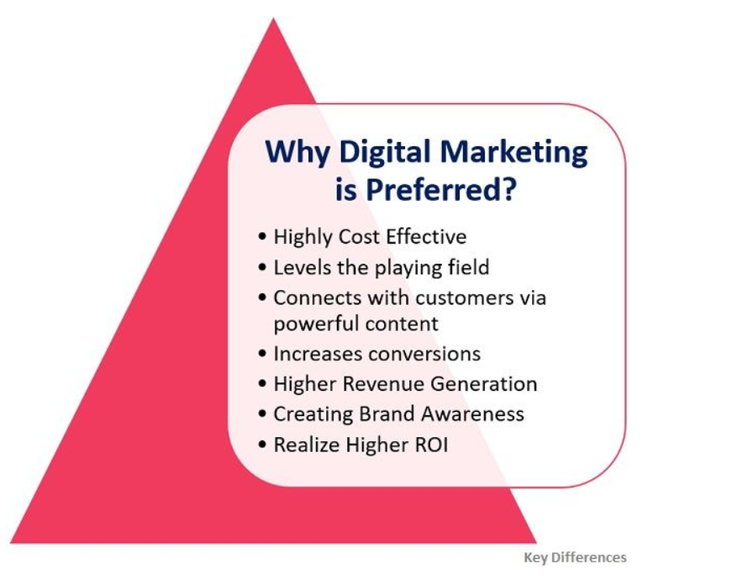

Slide 29
Benefits of Traditional Marketing
You can easily reach your target local audience
The materials can be kept
It's easy to understand.
The Downside to Traditional Marketing
There is very little interaction between the medium used and the customers.
Print or radio advertisements can be very costly
Results on this marketing strategy cannot easily be measured.

Slide 30
Benefits of Digital Marketing
You can target a local audience, but also an international one
Your audience can choose how they want to receive your content
Interaction with your audience is possible
Digital marketing is cost-efficient
Data and results are easily recorded
Level playing field:
Real time results:
Brand Development
Viral

Slide 31
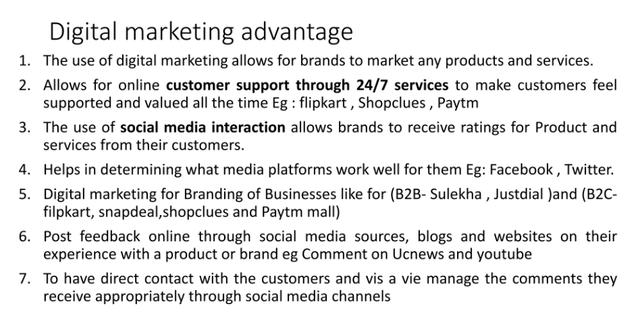

Slide 32
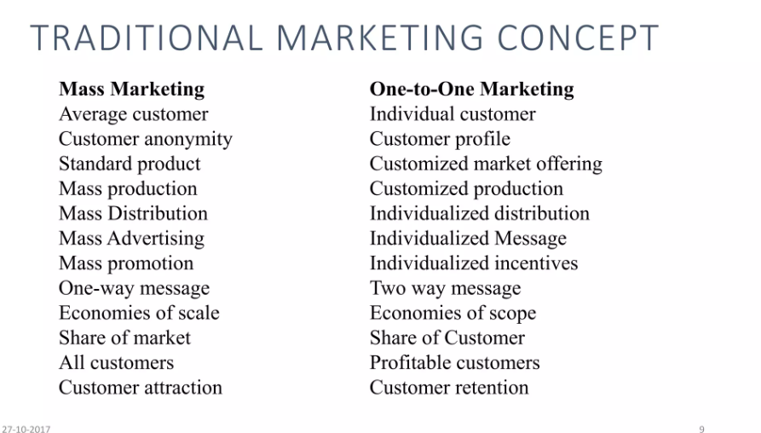

Slide 33
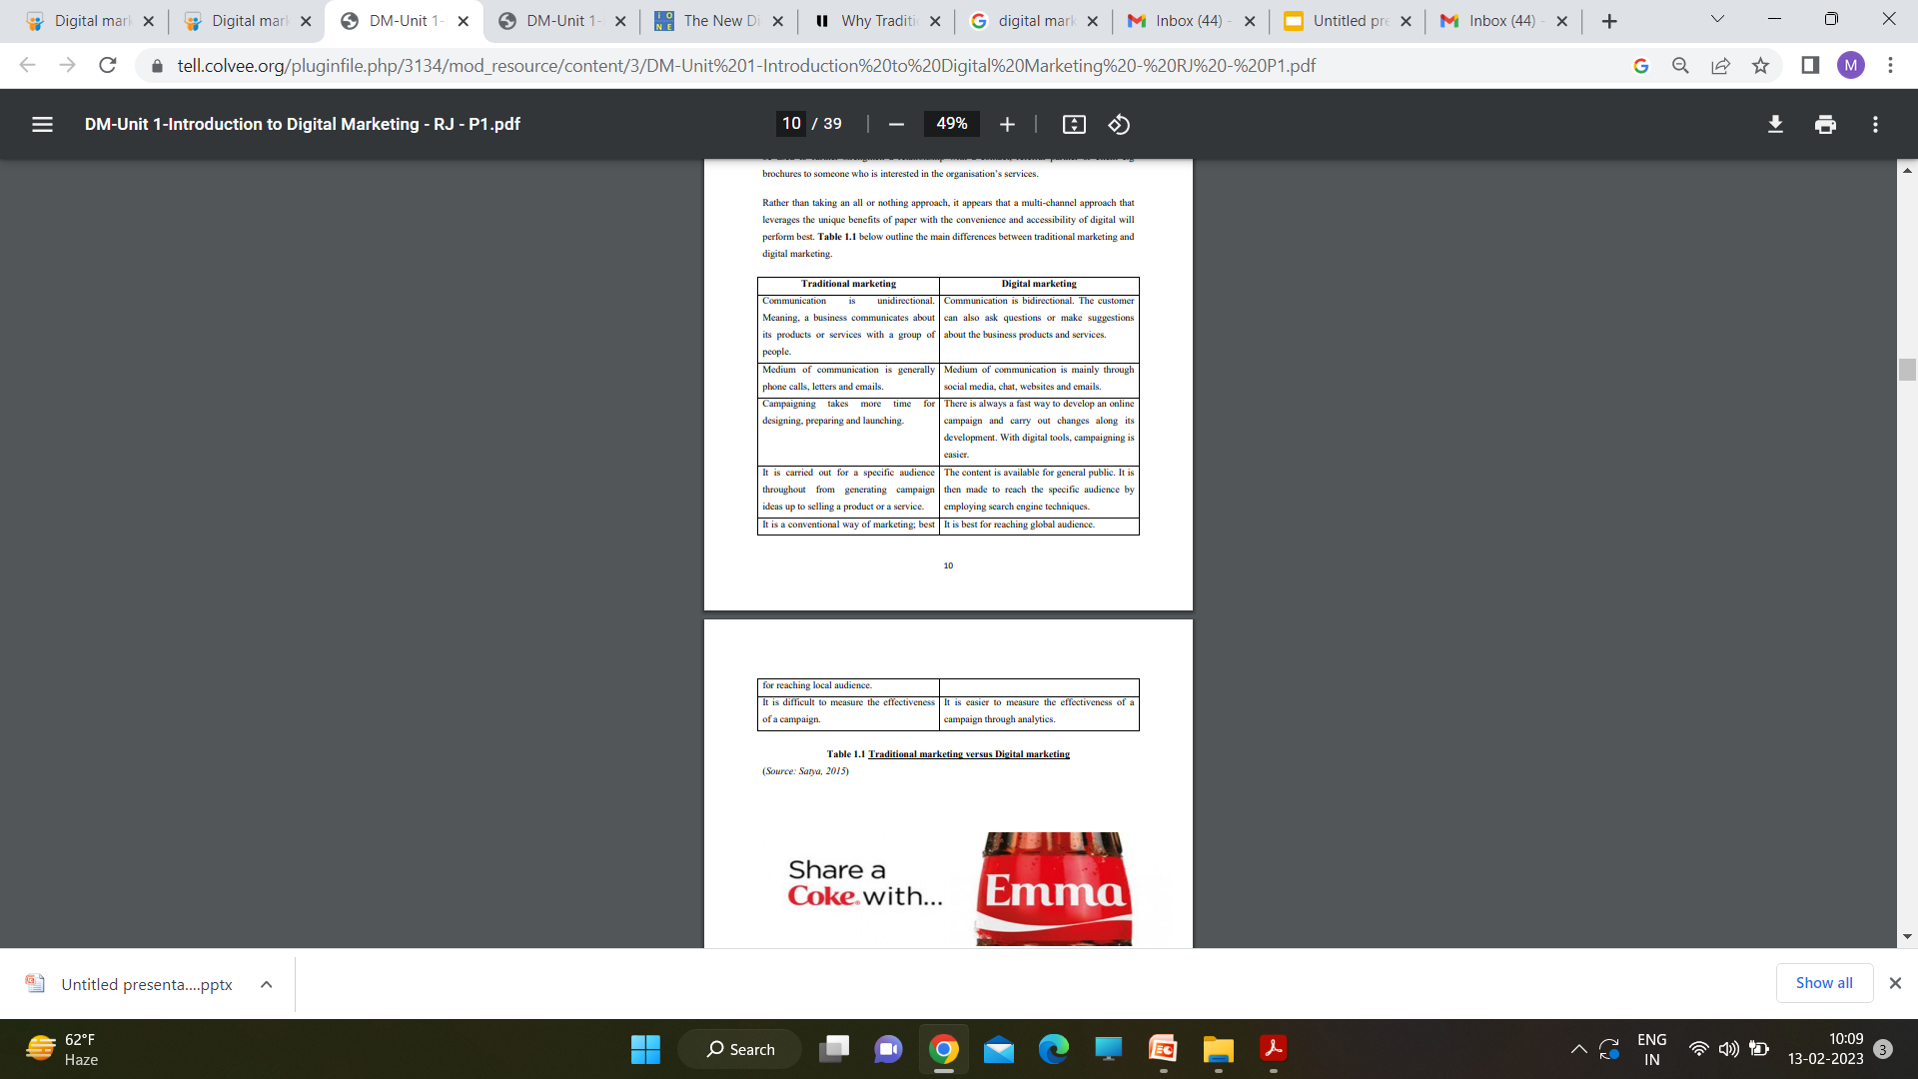

Slide 34
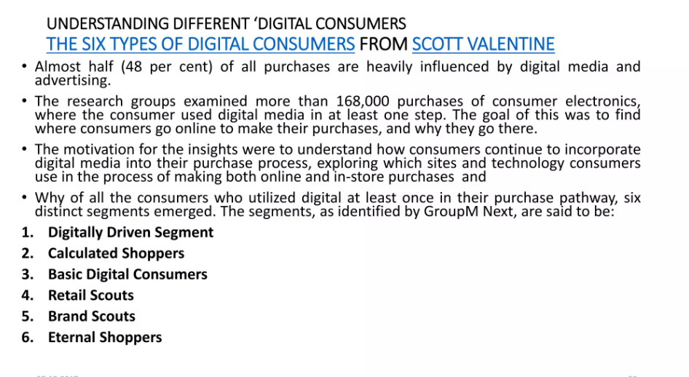

Slide 35
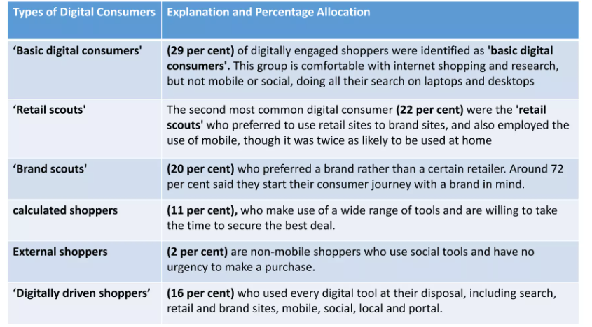

Slide 36
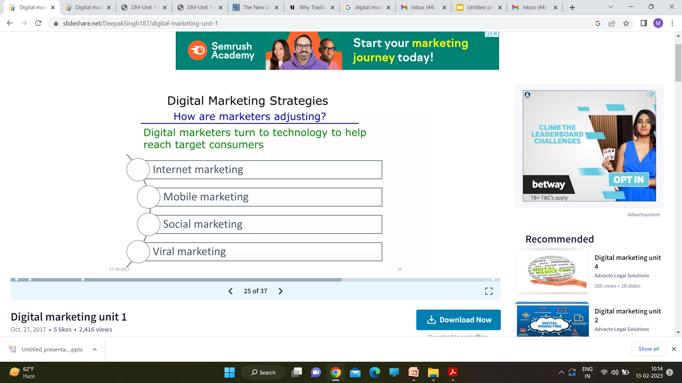

Slide 37
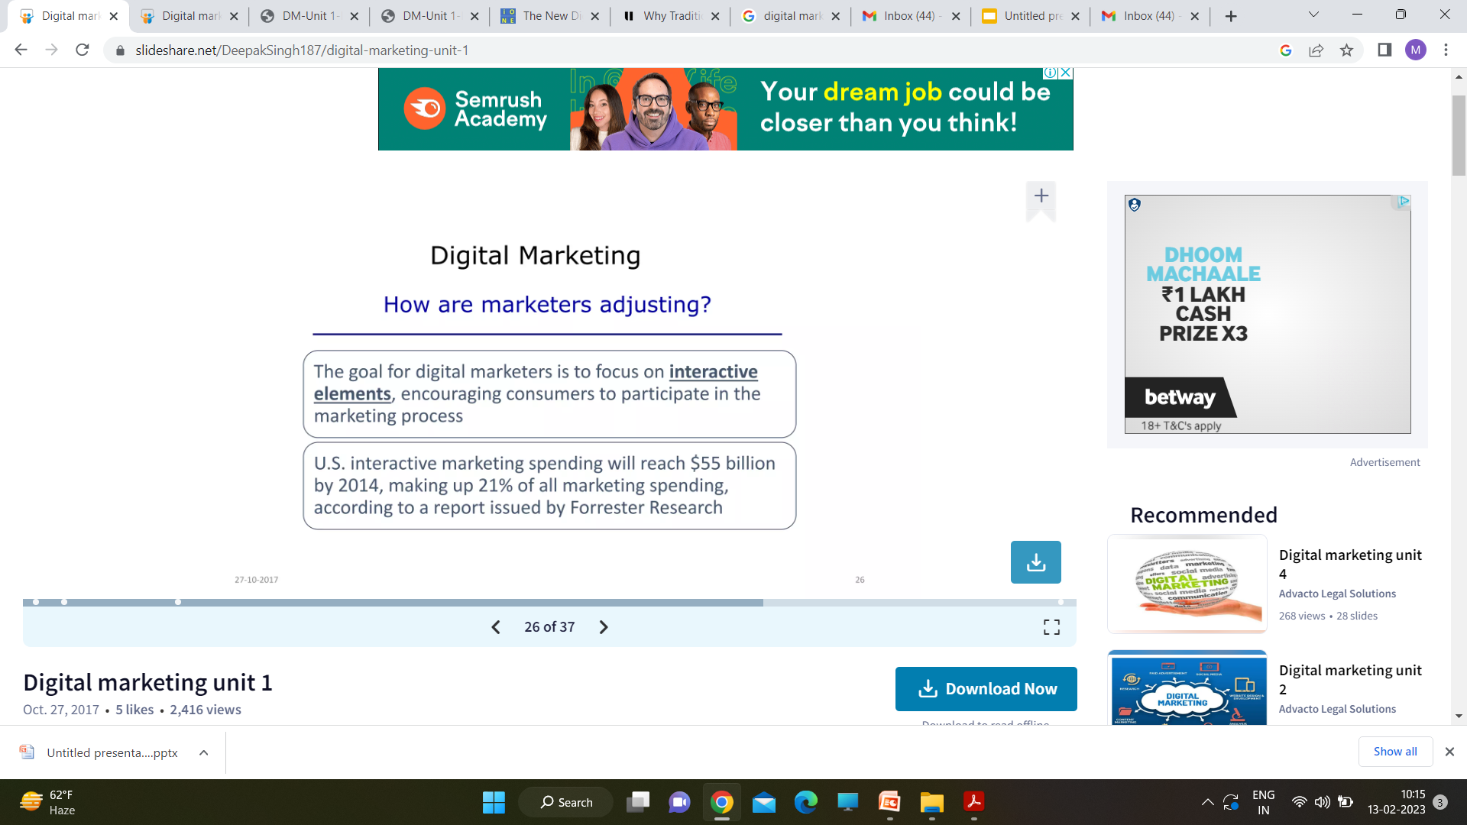

Slide 38
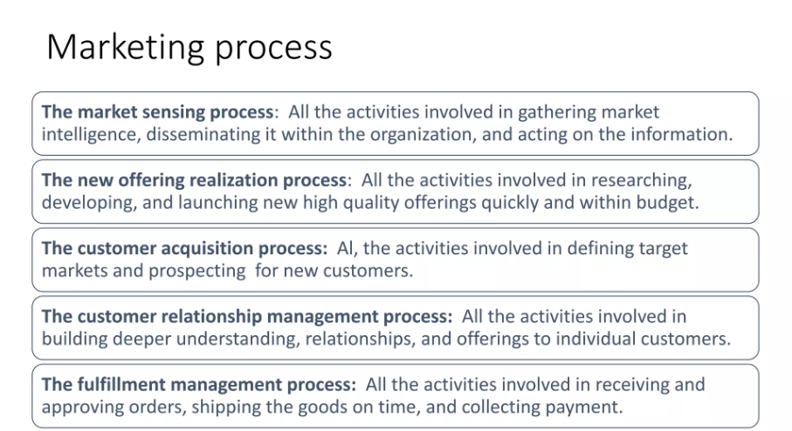

Slide 39
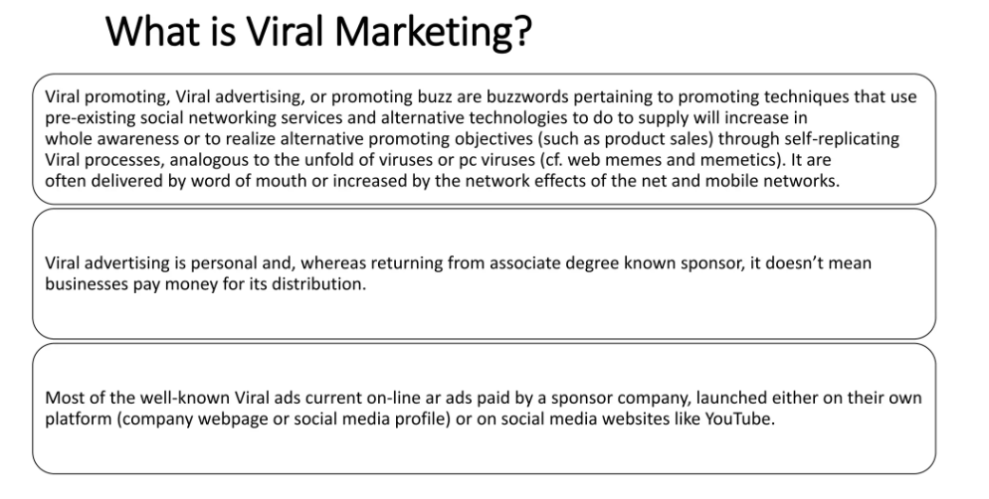

Slide 40
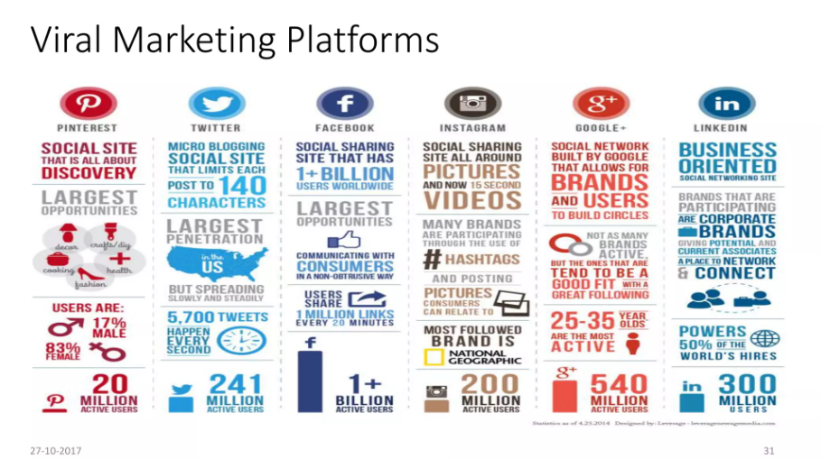

Slide 41
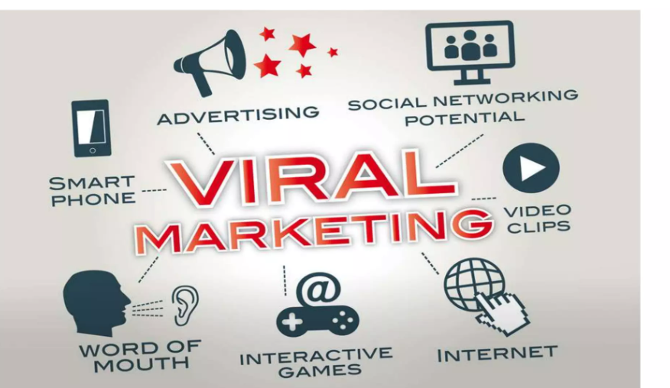

Slide 42
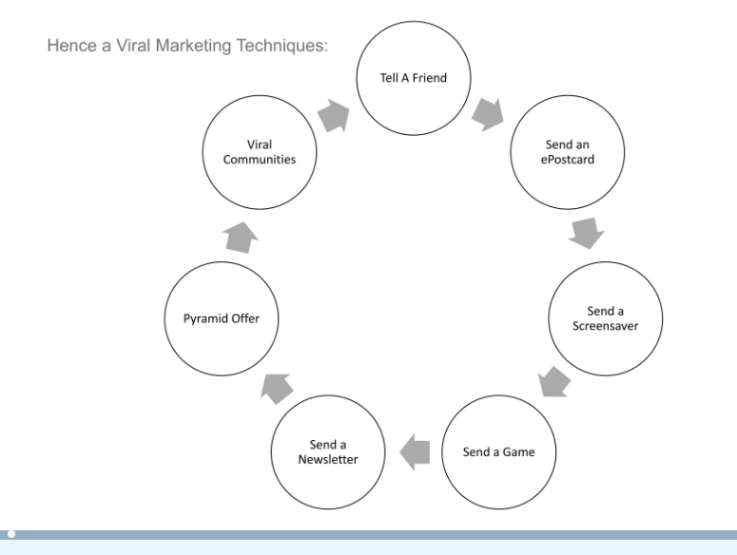

Slide 43
TYPES OF DIGITAL MARKETING APPROACHES – PULL AND PUSH DIGITAL MARKETING
There are two types of digital marketing and one of these is pull digital marketing. It aims to encourage consumers to come to you by visiting your business or making a call to action. Some of the common examples of pull digital marketing are websites and other internet based mediums.
Pull marketing is often called inbound marketing. Another type of digital marketing is push digital marketing. It pushes the marketing information directly to your customers. Common examples include SMS, email and RSS that target the customer with a customized message. Push marketing can also be called outbound marketing.

Slide 44
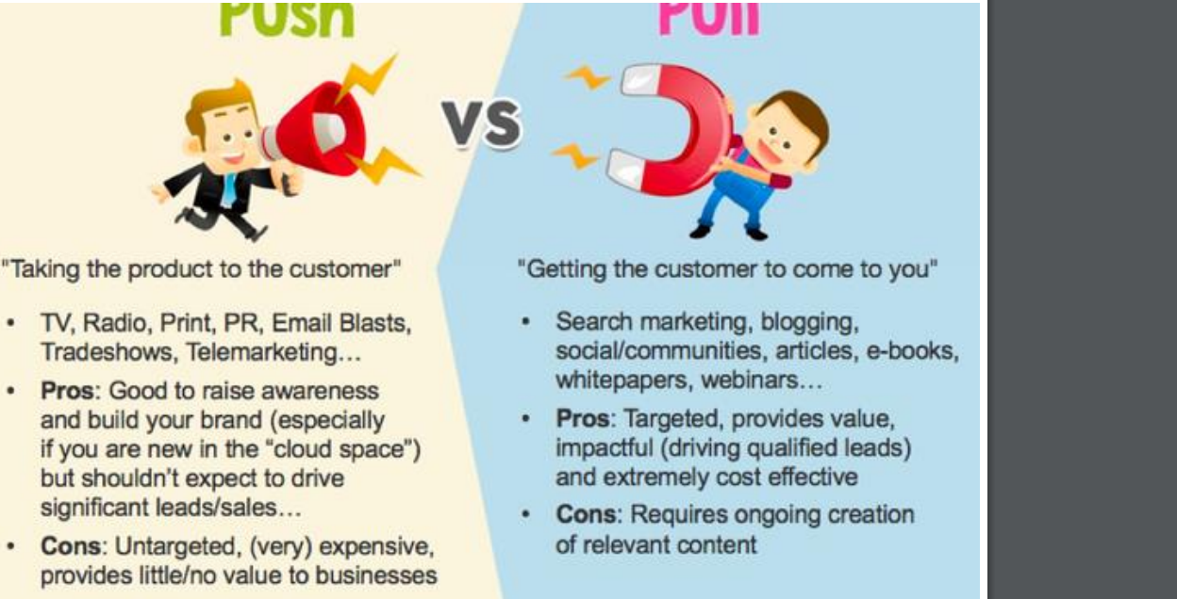

Slide 45
TYPES OF ONLINE PRESENCE
When assessing the relevance and potential of digital marketing for a business, remember that different business types offer different opportunities and challenges. Chaffey and Ellis Chadwick (2015) identify five main types of online presence or components possible as part of as site:
Transactional e-commerce site
Services-oriented relationship building or lead-generation web site.
Brand-building site
Brand-building site
Social network or community site

Slide 46
WHO NEEDS DIGITAL MARKETING SERVICES?
Digital marketing is an important to any business regardless of its size. It can help the business achieve a substantial leap by designing digital marketing strategy to differentiate the organisation from its competitors. Without the right digital marketing strategy, organisations may miss out opportunities for growth as more and more people are using digital technology to find information, buy products and assess the services they use.

Slide 47
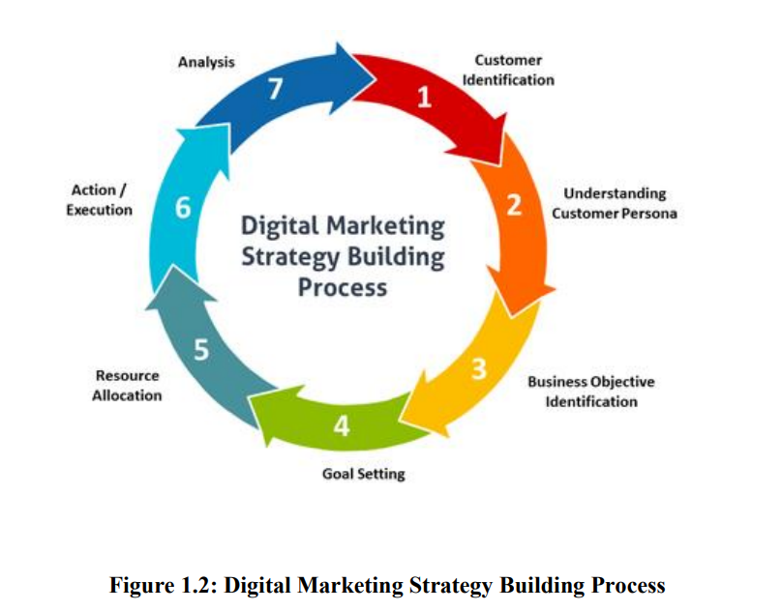

Slide 48
THE 4 PS OF MARKETING AND THEIR IMPLICATIONS FOR DIGITAL MARKETING
Product
Price
Place
Promotion

Slide 49
DIGITAL MARKETING PLATFORMS
An integrated digital marketing platform is a combination of integrated tools and technology that allow marketers to manage big chunks of their digital marketing responsibilities.
Digital marketing platforms expose key elements as standardized services via a programmatic application programming interface for building custom applications and extensions and integrations

Slide 50
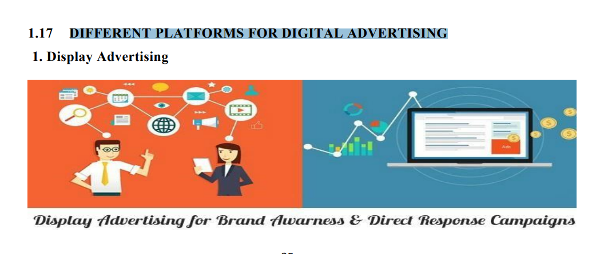
DIFFERENT PLATFORMS FOR DIGITAL ADVERTISING

Slide 51
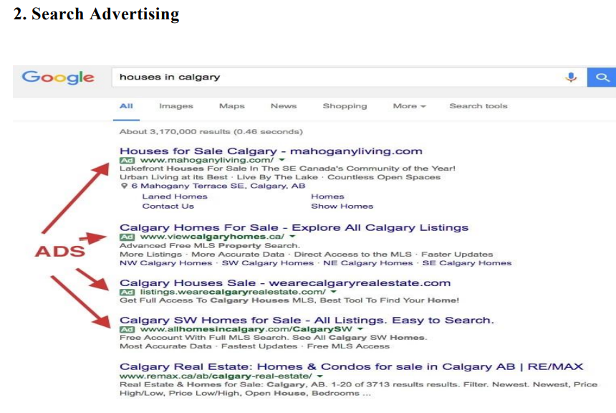

Slide 52
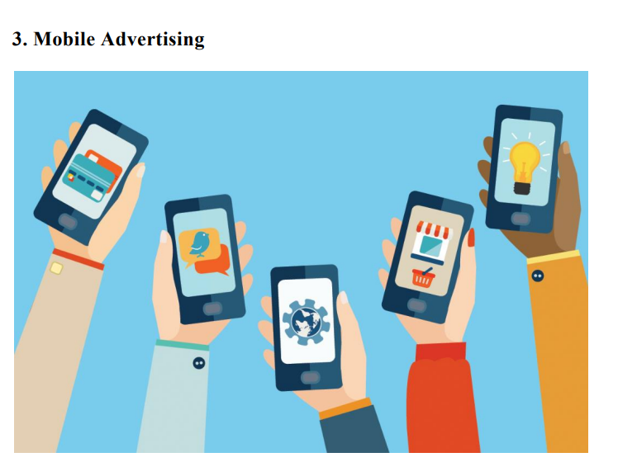

Slide 53
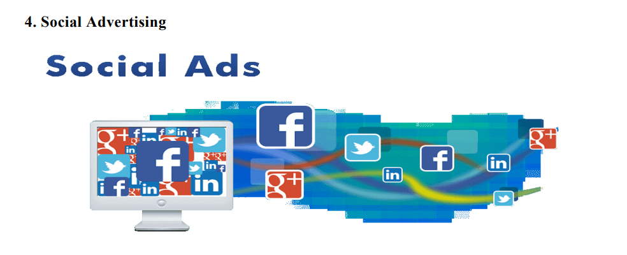

Slide 54
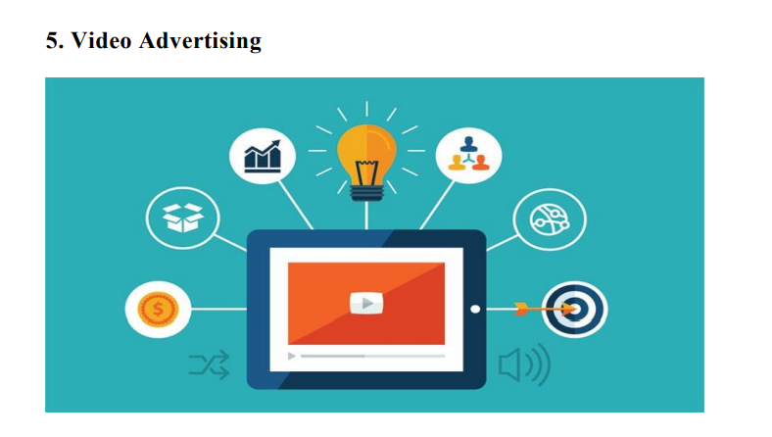

Slide 55
Types of Digital Marketing
Digital marketing can be broadly broken into 8 main categories including:
Search Engine Optimization (SEO)
Social Media Marketing
Pay-per-Click
Email Marketing
Mobile Marketing
Marketing Analytics
Affiliate Marketing
Content Marketing

Slide 56
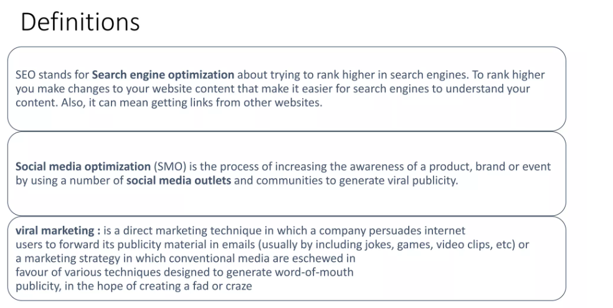

Slide 57
7 characteristics of modern consumer
While mobile connectivity has empowered the consumer to shop in different way- it has also created opportunities for retailers. Namely, it open the door for retailers to interact with costumers more purposefully and to become more personalized in those interactions.
Around the clock shopping - “when consumption can take place at any time of the day , retailers have to address the nuance and requirements of different consumer need throughout day”
Consumers are in control – “They have means to explore, research and share every purchase decision . And thy can do it in a very quick way. If you lose them, it may not be just for that purchase , it may be for long time. You have to be responsive to their needs immediately instead of trying to direct them. That balancing act is the biggest challenge. ”
Omnichannel shopping “No matter where he is shopping, the consumer is the consumer . You have to break down those barriers between channels, empower the consumer in a uniform way and engage them in the same way on your site as you would in your store. ”-Sahal Lahar Brook Brothers Executive Vice President
Content consumers “Thy have closer relationship whit what they are buying and reasons for buying it in their mind. Content has tremendous influence on how they’re behaving , so chico’s is also looking at content to complement decision in more enriched way for customers especially on social media. ”
Notes:
Chico---cloth brand

Slide 58
5. Global Experience “We need to understand the consumers’ needs wherever they are. Weather they are in our Tokyo shop or our NYC store, we need to arm associates with the tool that will make the customer interaction as meaningful as possible ”- Laher
6. Collaborators “There is lot more collaboration and sharing of information that can influence consumer decisions compared to the offline experience.”- Patel , Marketing executive e-bay
7. Social shares “ It goes beyond retails reviews of purchases. We are working with an outside partners to leverage social feedback befire we can have product in the store. We can have various online groops give feedback on ideas and colors before investing time and money to create different colors and incur the cost of manufacturing and shipping ,for example. That feedback mechanism didn’t exist before ” -Laher

Slide 59
Digital Marketing Tools
WordPress and Blogger (Blogging)
Twitter(Microblogging)
Facebook and LinkedIn (Social Networking)
Flickr and YouTube (Photo and Video Sharing)
Google Analytics (Monitoring Results)

Slide 60
Types of Digital Marketing
Digital marketing can be broadly broken into 8 main categories including:
Search Engine Optimization (SEO)
Social Media Marketing
Pay-per-Click
Email Marketing
Mobile Marketing
Marketing Analytics
Affiliate Marketing
Content Marketing

Slide 61
Search Engine Optimization (SEO)
SEO allows your content to rank in the top positions of search engines.
Thereby, your website will be found by someone who is actively searching for what you offer.
To apply SEO, you need to know the keywords that the audience, and want to reach is searching. Then, you must develop your content around these terms.
According to the Search Engine Journal, 91.5% of the web traffic is shared by sites listed on Google’s first page.

Slide 62
The first Google organic search, itself, gathers 32.5% of the traffic.
And 51% of all website traffic comes from organic search. Organic traffic is the one that you conquer through high-quality content found by searches in Google

Slide 63
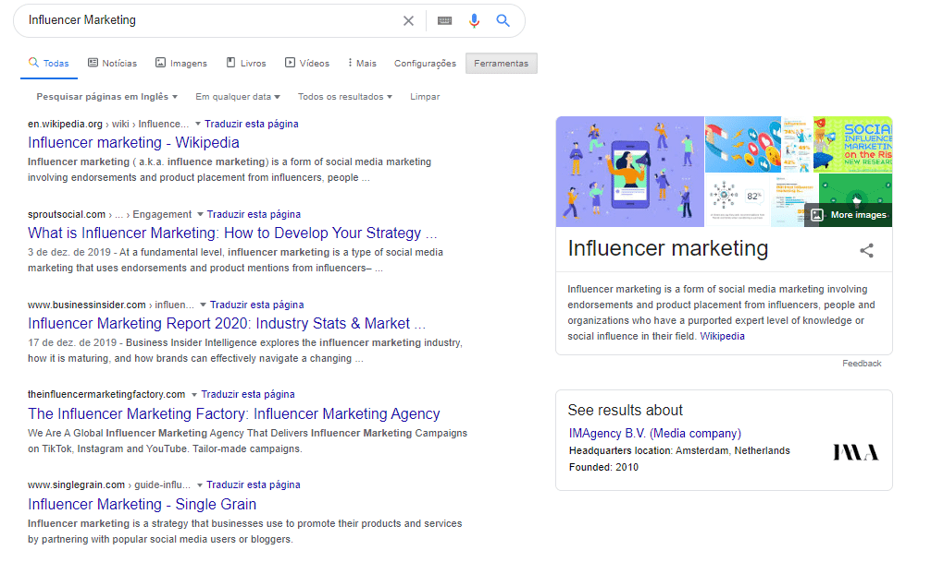

Slide 64
How does SEO work?
Search engines like Google and Bing use crawlers, sometimes also called bots or spiders, to gather information about all the content they can find on the internet.
The crawler starts from a known web page and follows internal links to pages within that site as well as external links to pages on other sites.
The content on those pages, plus the context of the links it followed, help the crawler understand what each page is about and how it’s semantically connected to all of the other pages

Slide 65
within the search engine’s massive database, called an index.
When a user types or speaks a query into the search box, the search engine uses complex algorithms to pull out what it believes to be the most accurate and useful list of results for that query.
These organic results can include web pages full of text, news articles, images, videos, local business listings, and other more niche types of content.

Slide 66
The pros
It’s free!
When your brand appears in the organic search results, it comes across as being more ‘authentic’ and objective in the eyes of your customers
The cons
You may not have to pay specifically for the search results, but it does take time and effort to create amazing content and do the technical optimization of your website

Slide 67
2. Social Media Marketing (SMM)
SSM, or Social Media Marketing, is, as the name suggests, a method that uses social media to promote a brand, product, or content.
Todays’ consumers are highly reliant on social media platforms such as Instagram, Facebook, LinkedIn, and Snapchat.
This is why it is essential that brands are active across accounts. Consider these stats:
On average users have about 8 social media accounts
An average of 2 hours and 22 minutes are spent on social media per person per day.
Out of the 5.11 billion people who have a phone, 3.26 billion access social media using it.

Slide 68
Current Market Scenario
Global Market
Customer driven market
Cutting edge competition
Brand is more powerful than Product
Transparency and Governance are more important.
Concept, stories and Audio-visual Content facilitate SALES.
Networking based business models.

Slide 69
Facebook Statistics
Statistics
864 million daily active users on average for September 2014
703 million mobile daily active users on average for September 2014
1.35 billion monthly active users as of September 30, 2014
1.12 billion mobile monthly active users as of September 30, 2014
Approximately 82.2% of our daily active users are outside the US and Canada
INDIA: More than 100 million active users. Second largest after USA.

Slide 70
LinkedIn Statistics
The world’s largest professional network on the Internet.
It has reached 300 million members in more than 200 countries and territories (As on September, 2014)
The company has added more than 23 million members since December 31, 2013.
Currently 67 percent of LinkedIn members are located outside the United States.
INDIA: More than 26 million users. Second largest after USA.

Slide 71
YouTube Statistics
More than 1 billion unique users visit YouTube each month
Over 6 billion hours of video are watched each month on YouTube—that's almost an hour for every person on Earth
100 hours of video are uploaded to YouTube every minute
80% of YouTube traffic comes from outside the US
YouTube is localized in 61 countries and across 61 languages
According to Nielsen, YouTube reaches more US adults ages 18-34 than any cable network.
40% YouTube visitors come from mobile.
INDIA: More than 55% unique users per month. 70% are below the age 36 yers.

Slide 72
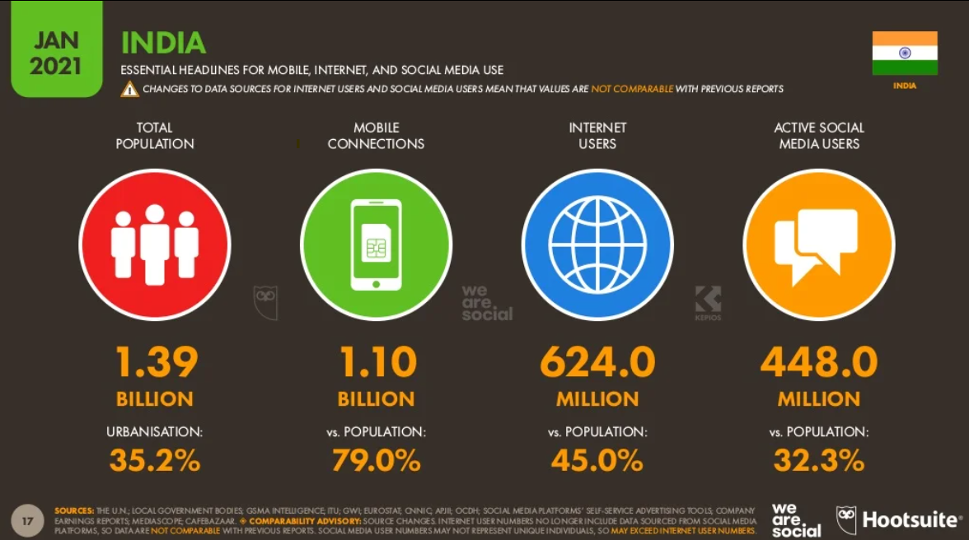

Slide 73
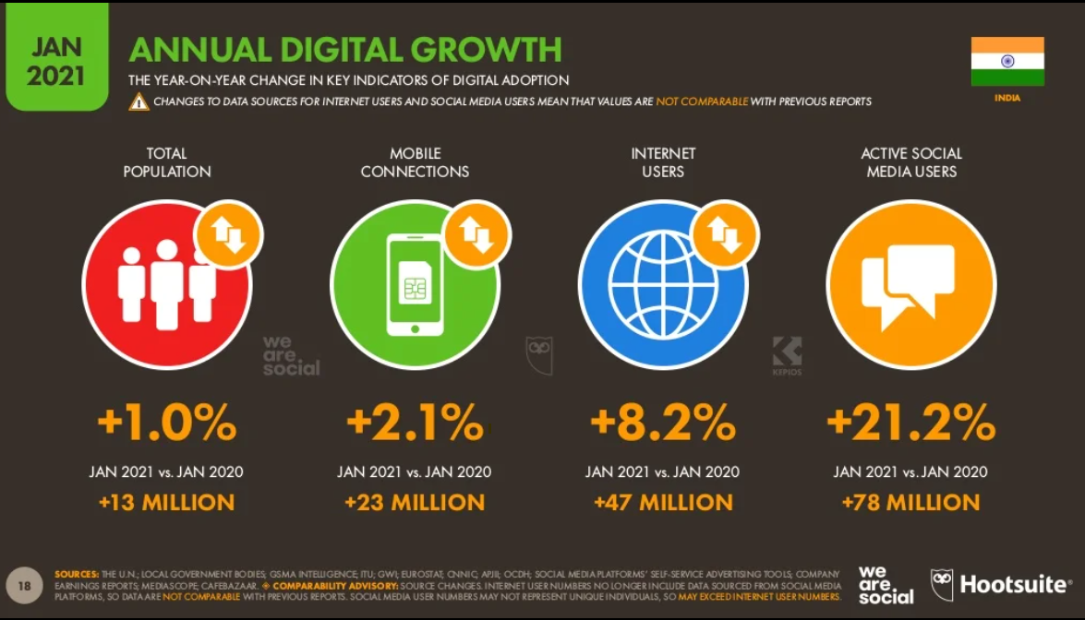
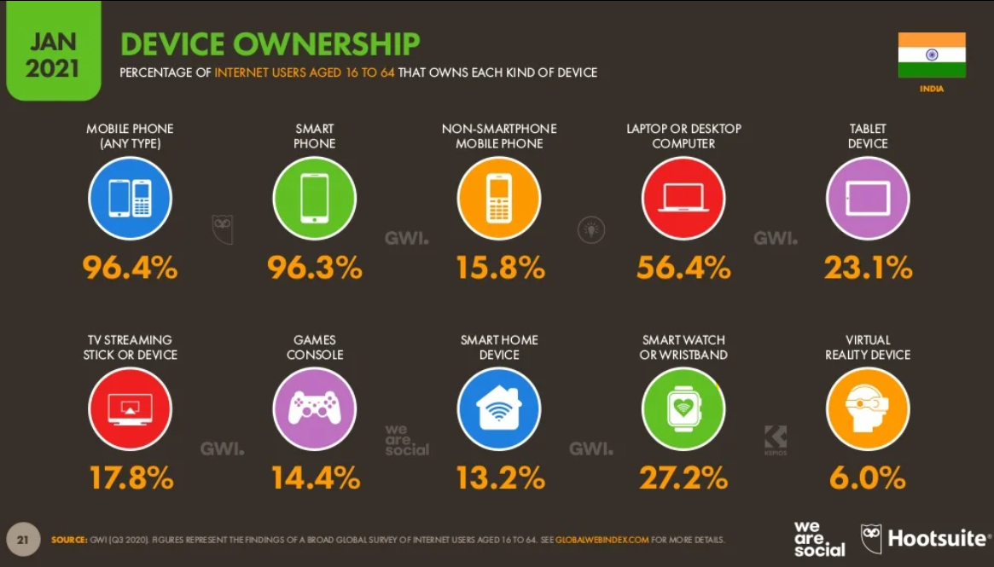
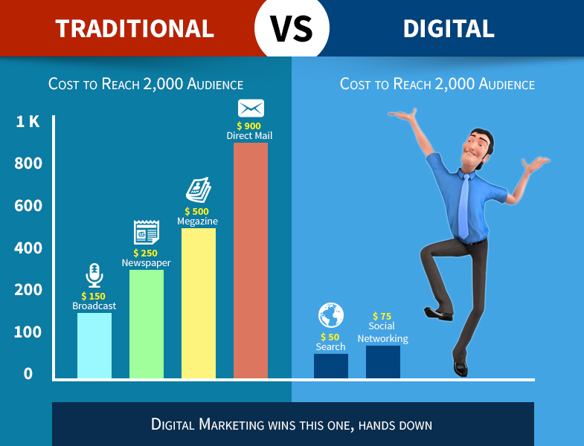

Slide 74
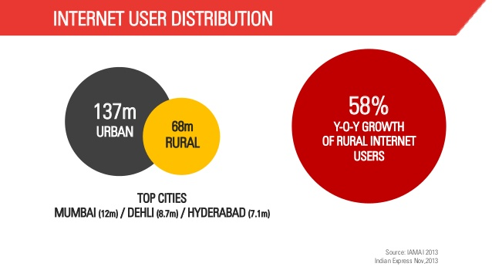

Slide 75
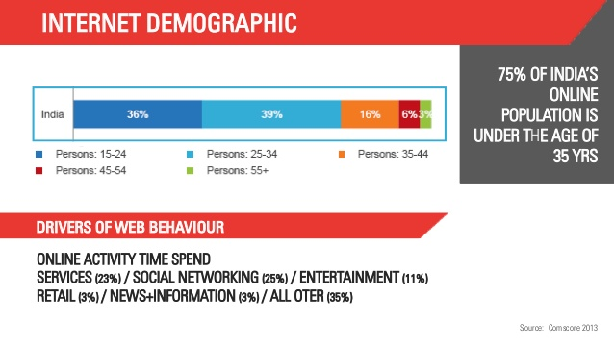

Slide 76


Slide 77
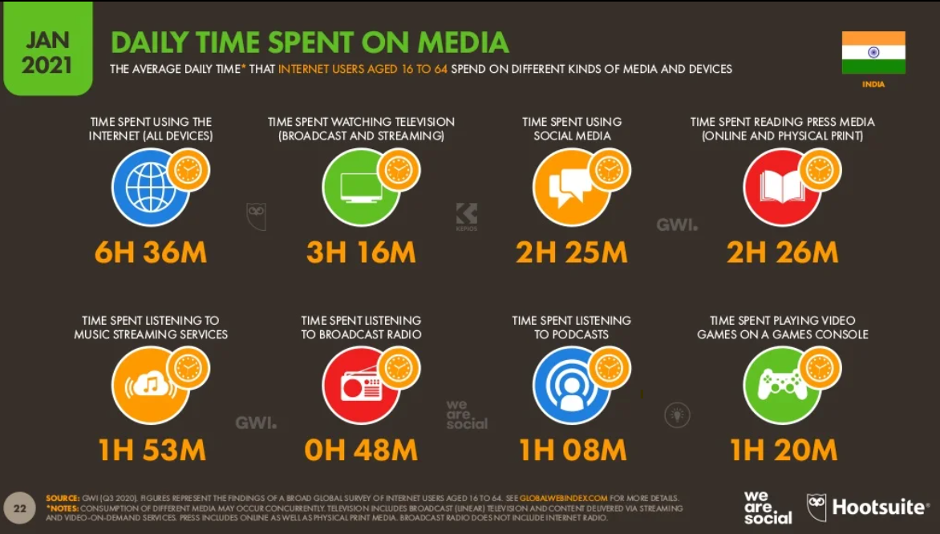

Slide 78
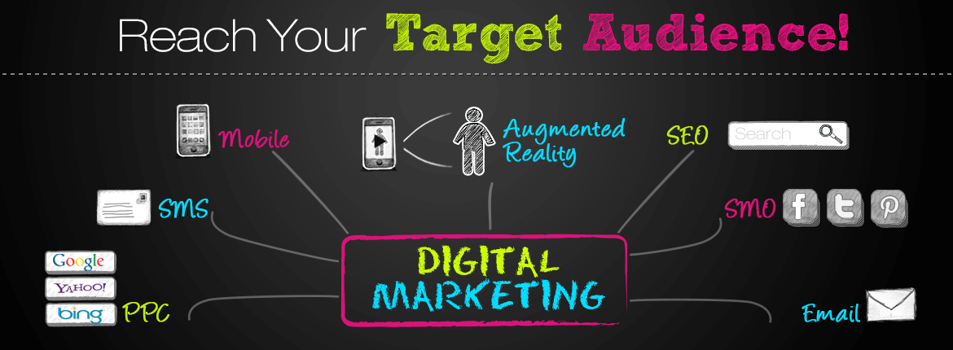

Slide 79
Digital Marketing Techniques
SEO : Optimize the website with relevant KEY WORDS, so that it achieves ‘naturally high’ search responses.
SEM: Search Engine Advertising. Bid on preferred KEY WORDS and go for ‘Pay Per Click’ (PPC) campaign.
Viral Marketing: Through Emails, Videos, Podcasts, Photos, Slideshows.
Podcast: An audio file (.MPV or .WAV format).

Slide 80
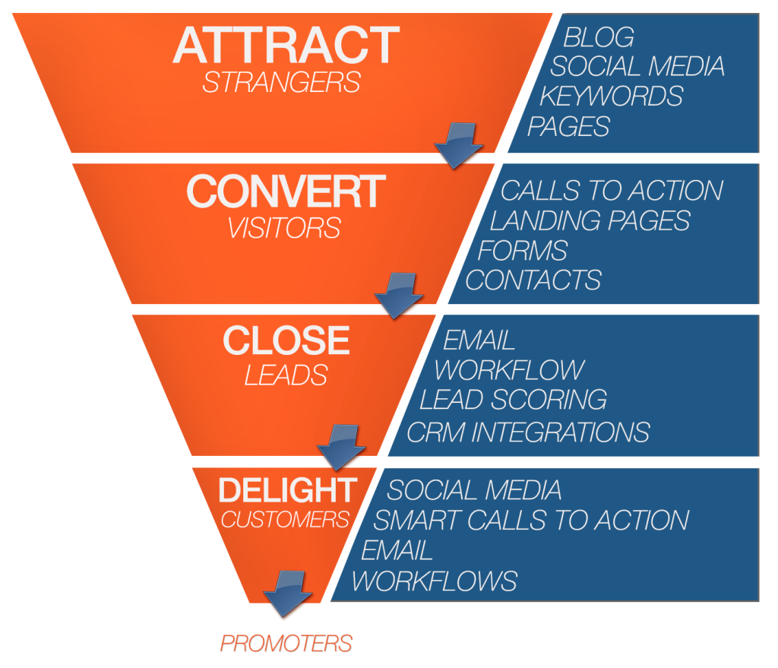
DIGITAL FUNNEL

Slide 81
Some Success Stories
Under The Dome Used Social Media Marketing To Reach 5.7 Million People
Fujifilm Used Social Media To Increase Its Popularity On Twitter By Gaining More Than 3000 Tweets
ADP Leveraged Social Media Marketing To Increase Its Company Page Followers By 100%
EagleRider Used Social Media Marketing To Smartly Garner 80% More Facebook Fans
Adventure Island Leveraged Social Media Marketing To Achieve 5x Rise In Page Likes Without Paid Ad Campaign
Sony Mobile India Achieved Over 2 Million Fans Through Social Media
Adolfo Ibanez School Of Management Used Inbound Marketing To Multiply Its Leads By 11 In First Month
Brightfire Smartly Used Inbound Marketing To Increase Its Revenue By 100%

Slide 82
ABBYY Used Inbound Marketing Tricks To Achieve 26% Growth In Website Visitors In An Year
Vico Software Used Inbound Marketing To Increase Its Search Referrals By 100%
Danaher Corporation Used Inbound Marketing To Outreach Its Marketing Goals In Just 1 Month
Texas Music Scene Used Inbound Marketing To Increase Its Page Views By 365%
Firefish Software Leveraged Inbound Marketing To Garner 190% More Leads

Slide 83
7 characteristics of modern consumer
While mobile connectivity has empowered the consumer to shop in different way- it has also created opportunities for retailers. Namely, it open the door for retailers to interact with costumers more purposefully and to become more personalized in those interactions.
Around the clock shopping - “when consumption can take place at any time of the day , retailers have to address the nuance and requirements of different consumer need throughout day”
Consumers are in control – “They have means to explore, research and share every purchase decision . And thy can do it in a very quick way. If you lose them, it may not be just for that purchase , it may be for long time. You have to be responsive to their needs immediately instead of trying to direct them. That balancing act is the biggest challenge. ”
Omnichannel shopping “No matter where he is shopping, the consumer is the consumer . You have to break down those barriers between channels, empower the consumer in a uniform way and engage them in the same way on your site as you would in your store. ”-Sahal Lahar Brook Brothers Executive Vice President
Content consumers “Thy have closer relationship whit what they are buying and reasons for buying it in their mind. Content has tremendous influence on how they’re behaving , so chico’s is also looking at content to complement decision in more enriched way for customers especially on social media. ”
Notes:
Chico---cloth brand

Slide 84
5. Global Experience “We need to understand the consumers’ needs wherever they are. Weather they are in our Tokyo shop or our NYC store, we need to arm associates with the tool that will make the customer interaction as meaningful as possible ”- Laher
6. Collaborators “There is lot more collaboration and sharing of information that can influence consumer decisions compared to the offline experience.”- Patel , Marketing executive e-bay
7. Social shares “ It goes beyond retails reviews of purchases. We are working with an outside partners to leverage social feedback befire we can have product in the store. We can have various online groops give feedback on ideas and colors before investing time and money to create different colors and incur the cost of manufacturing and shipping ,for example. That feedback mechanism didn’t exist before ” -Laher

Slide 85
Understanding the consumers Journey
It has been estimated that 57% of buying process is complete before ‘sale ’ is contacted.
Think about a consumer going to a retail store in mall to purchase phone. While the sales representative will try and push the consumer to purchase a particular product, the consumer-before entering the store –has already his or her homework. He or she has researched the brand on social, read product review, compared price and more.
Brands cannot only react to consumer as they make purchasing decision but also actively shape those decision journey.

Slide 86
We have found that a company ability to deliver that value relies on four interconnected capabilities
Automation streamlines journey steps. Letting people take a picture of check and deposit it through bank apps rather then depositing in person in bank . While automation of process is highly technical, the focus is on enabling simple, useful and increasingly engaging experience.
Proactive personalization use information about a customer-either based on past interaction or collected from external source –to instantaneously customize the experience
Contextual interaction use knowledge about where a customer is in journey to deliver them to the next set of interaction, such as retail site showing customer the status of recent order on the home page. Some hotels are experimenting with using their app to operate like a key when customer gets to his or her room.

Slide 87
Journey innovation extends the interaction to new source of value , such as new services, for both the customer and the brand. Companies min their data and insight about a customer to figure out what adjacent services he or she might appreciate. The best companies design journey that enables open-ended testing to allow for constant prototyping of new services or features. This may include, for example, an airline’s app that has the ability to integrate with a taxi services so that travelers can book cars to pick them up when they arrive at the destination.
-> Activating customer journey to capture value requires journey to be treated lime product that need to be actively managed, measured, and nurtured. How well companies are able to do that will dictate how successful they are in making customer journeys competitive advantages .

Slide 88
Marketing Strategies For Digital World
With technology’s rapid evolution also come changes in consumers behavior . Here are 10 strategies to emerge into a smarter marketing era, grow as a company and strengthen the performance of your brand.
Marketing: integrate your sales and marketing for optimal performance
Experience: Reaching a digital customer, requires that you become one yourself.
Playing Field Dynamics: Not every digital marketing challenges is solved by throwing more money at it.

Slide 89
Engagement: Having Digital Presence is not enough
Who’s In The Driver’s Seat? Let data drive the decision-making
Value: You must offer education & value
Personalized Automation: So you don’t lose that personal touch
Get Out more: Your customers don’t spend all their time in one place, neither should you.
Digital Agility is a must
Chatter matters : Business practices, Good and bad, will catch up with you eventually.

Slide 90
